Slide 1
Treatment of SARS-CoV-2-induced pneumonia with NAD⁺ and NMN in two mouse models

Slide 2
Introduction

Slide 3
SARS-CoV-2 (severe acute respiratory syndrome coronavirus 2)
SARS-CoV-2 has caused the global epidemic of COVID-19.
Critical COVID-19 cause severe respiratory distress, and many people died from it.

Slide 4
Reference from other research
Disturbance in the sera of COVID-19 patients was the increase of metabolites related to de novo production of NAD^{+*}.
Whether and how NAD⁺ metabolism is disrupted in the lungs of COVID-19 patients is still not clear.
NAD+ has been proposed as a inhibitor for SARS-CoV-2 protease (Mpro, PLpro)*.
NAD+ supplementation effectively alleviates cell death and inhibits microglia activation in Zika virus (ZIKV)-infected mouse brains*.
Mpro : main protease
Plpro : papain-like protease
microglia : macrophage of central nervous system

Slide 5
motivation
Although vaccines have been developed, COVID-19 epidemic’s quickly mutation has prioritized the development of drugs for COVID-19 treatment.
Therefore, it is intriguing to explore whether NAD⁺ or its intermediates are protective from SARS-CoV-2 infection.

Slide 6
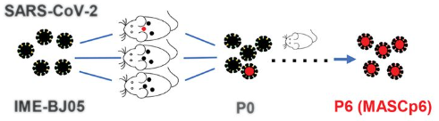
MASCp6 (mouse-adapted strain of SARS-CoV-2 at passage 6)
Notes:
To generate a SARS-CoV-2 mouse-adapted strain, the human clinical isolate of SARS-CoV-2 (BetaCov/human/CHN/Beijing_IME-BJ05/2020, abbreviated as IME-BJ05) was serially passaged by means of intranasal inoculation in aged mice, as previously described for SARS-CoV. Briefly, 9-month-old BALB/c mice were intranasally inoculated with 7.2 × 10⁵ plaque forming units (PFU) of SARS-CoV-2, and the lung tissues were collected from each passage for viral RNA load analysis at 3 days after inoculation.

Slide 7
MASCp36 (mouse-adapted strain of SARS-CoV-2 at passage 36)
P36(MASCp36)

Slide 8
Different from Two mouse model
MASCp6
caused moderate lung damage in mice*.
MASCp36
more virulent mouse-adapted strain*.

Slide 9
Gene Ontology (GO)
Major bioinformatics to unify gene and gene product data across all species
1. manage vocabulary of gene & gene product
2. annotate genes & gene products
3. provide tools for easy access to all aspects of the data provided by the project enable functional interpretation of experimental data using the GO (via enrichment analysis).

Slide 10
Result

Slide 11
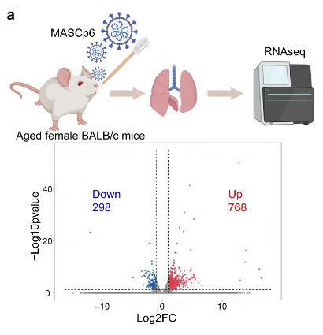
Analyze a total 1066 significantly differentially expressed genes in the infected lungs.
Notes:
(|log2FoldChange (FC)| > 1, P < 0.05, -log(p value) > 1.3)
1→2, FC=2, lgFC=1

Slide 12
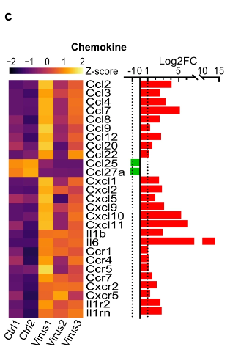
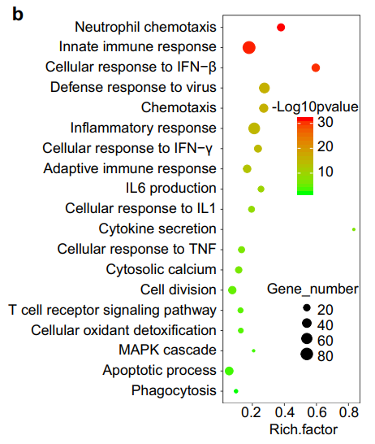
1. GO analysis of significantly upregulated gene. 2. Robust induction of chemokine, interleukin, and related receptor genes.
Rich factor : significantly differentially expressed genes/total genes of GO term
Notes:
Gene ontology (GO) enrichment analysis of significantly upregulated genes revealed the strong activation of immune related biological processes
neutrophil chemotaxis(S100a8, S100a9)
innate immune response
adaptive immune response
cellular response to IFN, TNF, and IL
as well as apoptotic process
phagocytosis

Slide 13
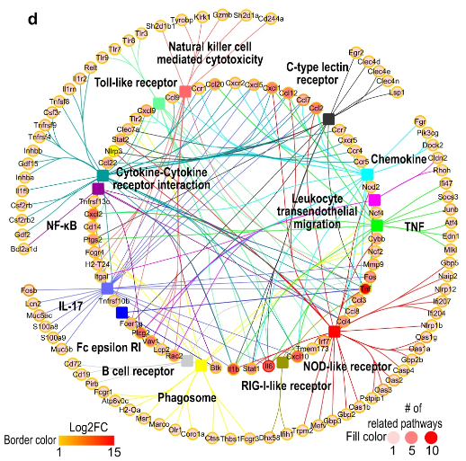
To inspect the induced immune-related genes and pathways by MASCp6 in more detail, we performed KEGG enrichment analysis.
Pathway
Gene
KEGG:
Kyoto Encyclopedia of Genes and Genomes
Notes:
To inspect the induced immune-related genes and pathways by MASCp6 in more detail, we performed KEGG enrichment analysis. Cytokine–cytokine receptor interaction, NOD-like receptor signaling, IL-17 signaling, chemokine signaling, TNF signaling, Toll-like receptor signaling, as well as other immune pathways were detected

Slide 14
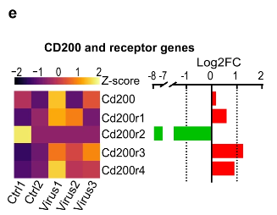
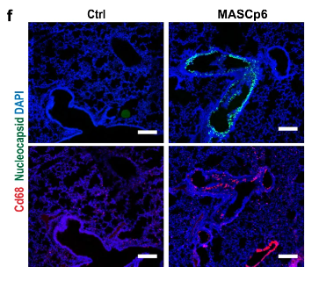
Cd200r3 and Cd200r4, were upregulated.(left) Consistent with immunofluorescence results(right)
CD200r3/r4 : Deliver an signal to macrophage (macrophage control)
CD68 : macrophage marker

Slide 15
These results indicated that innate immune response is activated robustly as that in COVID-19 patients*.
SARS-CoV-2-infected murine model mimics some of the immune features present in patients*, and it is suitable for testing drugs.

Slide 16
SARS-CoV-2 infection induces high expression of massive inflammatory genes and even triggers cytokine storm, which is considered to be the main cause of death in severe COVID-19 patients*.

Slide 17
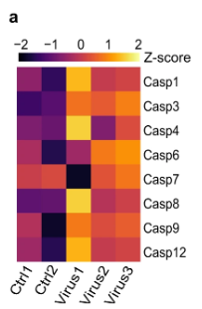
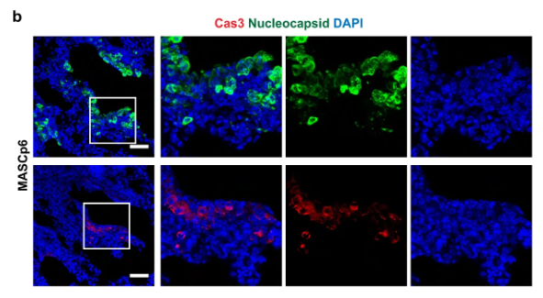
Many caspase family members were upregulated after infection(left) The presence of many cleaved caspase 3 ⁺ cells confirmed that apoptosis occurred in infected lungs(right)
Capase : main proteases of apoptosis
Casp3 : reveal apoptosis

Slide 18
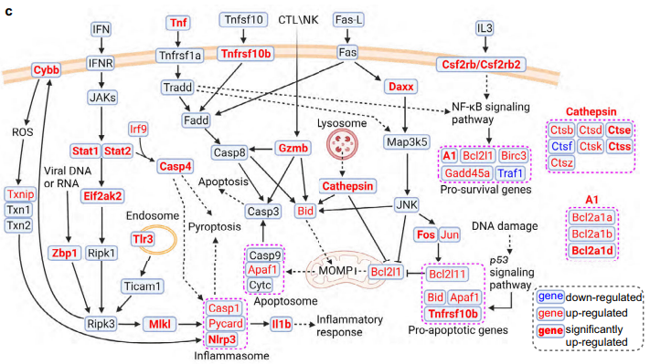
Schematic diagram (BioRender.com) :
apoptosis and pyroptosis/necroptosis pathways

Slide 19
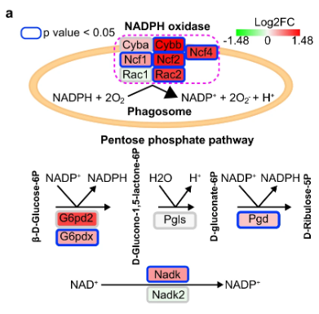
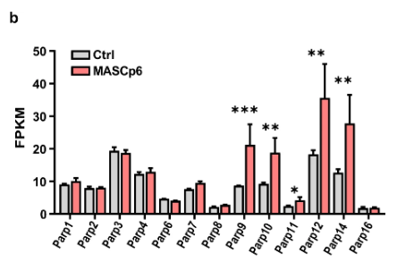
1. Cybb and other NADPH oxidase gene 2. Parp9, Parp10, and Parp14 was significantly induced in MASCp6-infected mouse lungs
Cybb : the critical component of NADPH oxidase that generates ROS
ROS : Reactive Oxygen Species

Slide 20
NADPH oxidase
Important role in Immune response*
- Neutrophil extracellular trap formation
- Phagosome maturation

Slide 21
PRAP (Poly ADP-Ribose Polimerase)
In MASCp6-infected lungs, Parp9, Parp10, and Parp14 regulate immune and inflammatory responses*.
PARPs were significantly upregulated while NAD⁺ levels were substantially reduced in ZIKV-infected mouse brains.*
([NAD+] reduced while [PARP] upregulated)

Slide 22
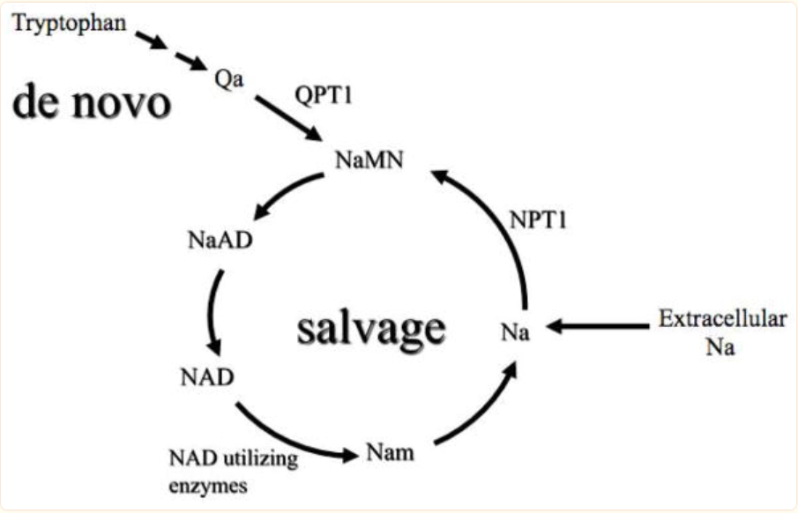
NAD (Nicotinamide adenine dinucleotide)
NAD⁺ is essential for multiple metabolic pathways*.
NAD synthesis(de novo & salvage pathway)

Slide 23
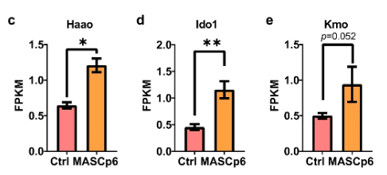
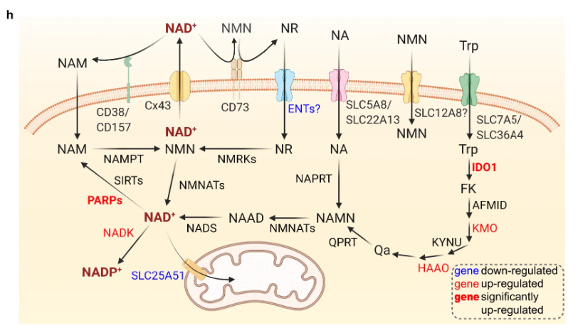
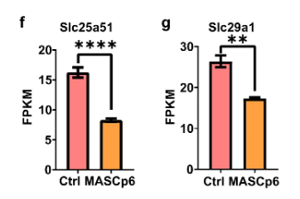
1.NAD ⁺ de novo synthesis gene (Haao, Ido1,Kmo) were upregulated. ([NAD ⁺ ] reduced → NAD ⁺ synthesis) 2.Slc25a51 and Slc29a1(Ent1)are Downregulated 3.Slc25a51 downregulated → impaired mitochondria function*.
Slc25a51 : mitochondrial NAD+ transporter gene
Slc29a1 (Ent1) : a nucleoside transporter gene
NR : nicotinamide riboside

Slide 24
The above results suggest that over-consumption of NADPH by upregulation of NADPH oxidase
(NADPH → ROS)
Upregulation of PARPs lead to reduced NAD ⁺ level.
([PRAP] upregulated → [NAD ⁺ ] reduce)
The reduction of NAD ⁺ level would stimulate the compensatory de novo synthesis of NAD ⁺
([NAD ⁺ ] reduce → NAD ⁺ de novo synthesis)
Mitochondrial functions can be predicated to be affected in the infected lungs.

Slide 25
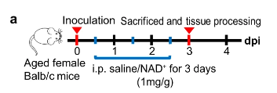
To investigated whether NAD ⁺ supplementation could rescue MASCp6-induced pneumonia. (MASCp6 saline v.s NAD ⁺) Treated infected mice (MACSp6) with NAD ⁺

Slide 26
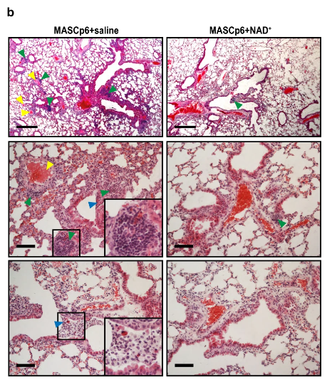
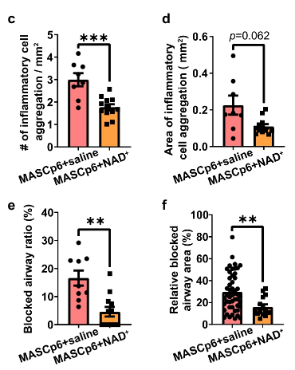
Inflammatory and blocked airway were substantially reduced ,no hemolysis in NAD ⁺ treatment group.
cell infiltration
airway blockage
hemolysis

Slide 27
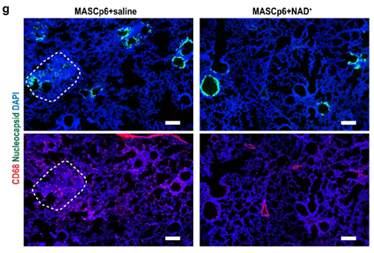
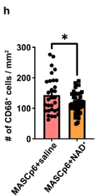
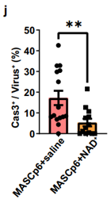
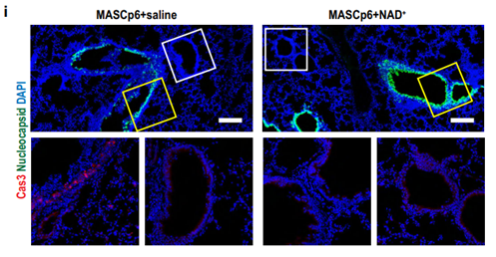
1.The number of macrophages was reduced 2.Cell death was suppressed in NAD ⁺ -treated mice
CD68 : macrophage marker
Cas 3 : apoptosis indicator

Slide 28
The treatment relieves the pathological damages.
NAD ⁺ supplementation can protect the lung from inflammatory injury (including cell death) caused by SARS-Cov-2 infection.

Slide 29
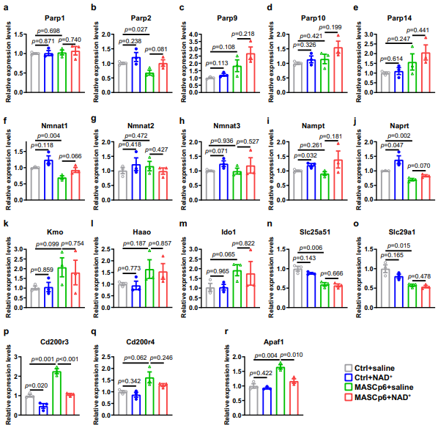
Effect of NAD ⁺ supplementation (qPCR)

Slide 30
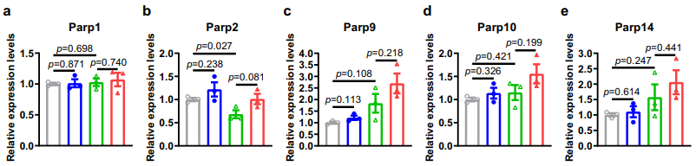
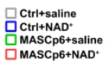
Expression of PARP family genes in the infected lungs

Slide 31
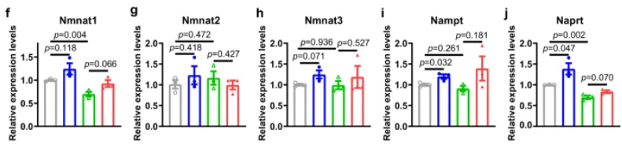
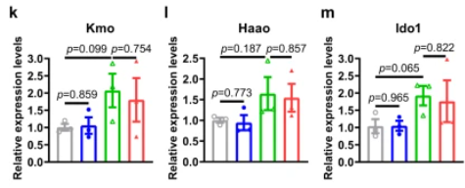
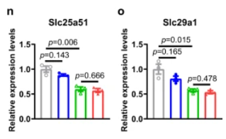
1.Genes associated with NAD ⁺ synthesis (salvage and de novo pathway) 2.Slc26a51 and Slc29a1(Ent1)

Slide 32
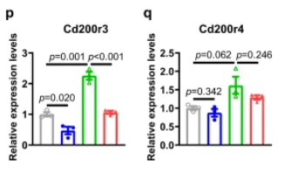
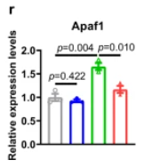
Apaf1 : apoptosis protease activating factor

Slide 33
qPCR results confirmed many findings from RNA-seq analysis
NAD ⁺ supplementation was beneficial to the maintenance of the NAD system
severe inflammatory cell infiltration and cell death might be rescued by NAD ⁺ treatment

Slide 34
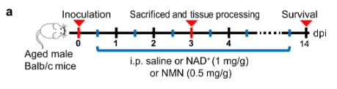
To examine whether NAD ⁺ intermediates(NMN) have similar therapeutic effects we adopted a more severe infection model (MASCp36 NAD ⁺ v.s NMN) Infected mice were treated with NMN or NAD ⁺
NMN (Nicotinamide mononucleotide) : a key NAD ⁺ intermediate

Slide 35
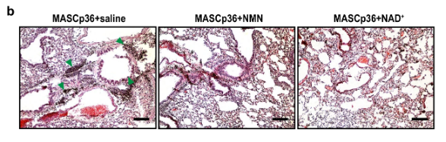
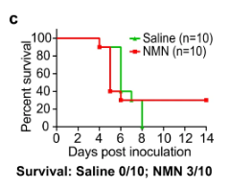
Pathological damage and survival ratio of mice after NAD ⁺ and NMN treatment
Inflammatory
cell aggregate

Slide 36
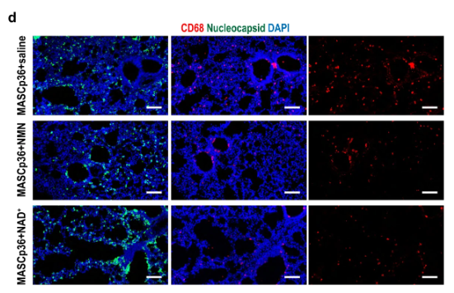
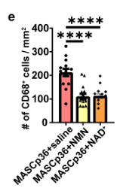
Both the number of CD68 ⁺ cells were reduced significantly in both NMN and NAD ⁺ groups

Slide 37
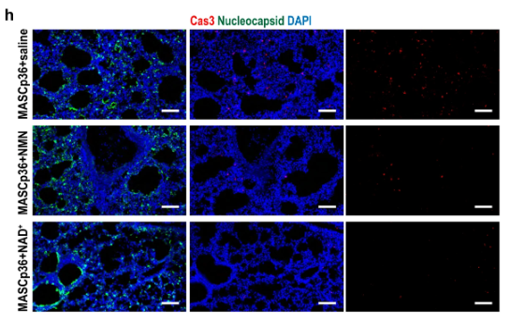
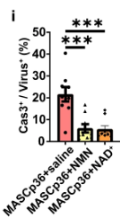
Cell death was substantially suppressed by NMN and NAD ⁺ treatment

Slide 38
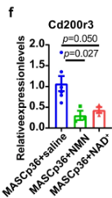
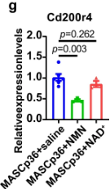
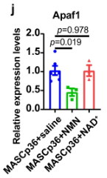
The suppression of Cd200r4 and Apaf1 expression was significant in the NMN group, but not in NAD ⁺ group of MASCp36- infected lungs

Slide 39
These results indicate that NMN supplementation alleviate inflammatory injury in the lungs and even death of the infected animals.

Slide 40
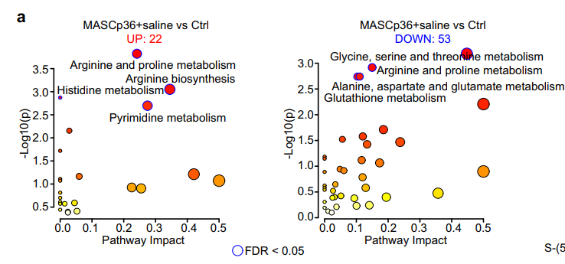
Analyze a total of 75 significantly deregulated metabolites detected in infected group(KEGG analysis)

Slide 41
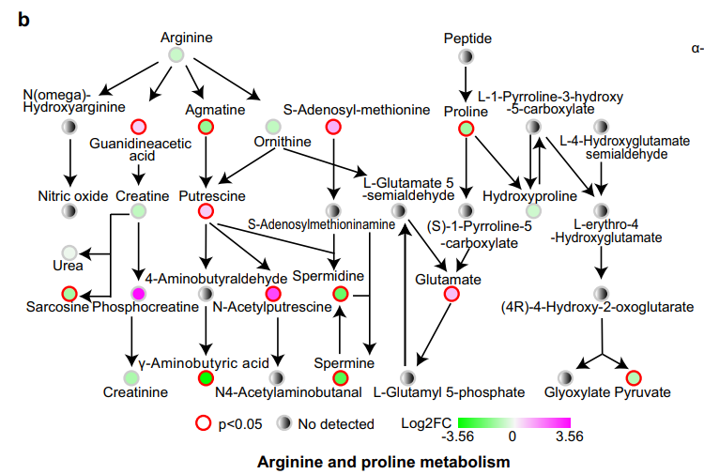
Many metabolism pathways were significantly affected by MASCp36 infeciton (ex:arginine and proline metabolism, etc) Downregulation of GABA was most significant one in the lungs after MASCp36 infection
GABA : γ-aminobutyric acid

Slide 42
GABA
GABA-related dysfunction has been postulated as the cause of seizure in COVID-19 patients*.
Administration of GABA or GABAa receptor agonists could limit pneumonitis and death in coronavirus-infected mice*.
Therefore, GABA is a potential candidate to treat SARS-CoV-2 infection

Slide 43
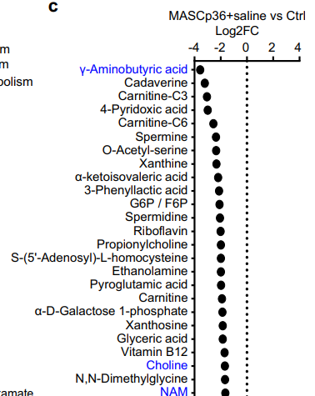
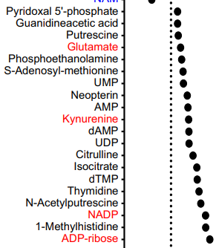
1. The significant upregulation of NADP+ was consistent with our transcriptomics analyses, in which Nadk was significantly upregulated
2. ADP-ribose was the most significantly upregulated one in the lungs
3. SARS-CoV-2 Nsp3 counters ADP-ribosylation by PARPs*.
4.Downregulation of choline and upregulation of kynurenine , glutamate in the sera have been reported to be associated with the severity of COVID-19 patients*.
Nsp : None structural protein

Slide 44
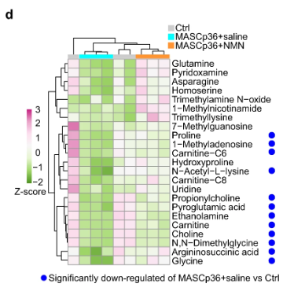
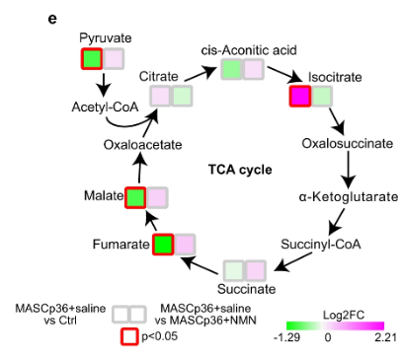
1.Analyze a total of 23 significantly differential metabolites were detected in the NMN group
2.Dysregulation of TCA cycle’s metabolites (matabolites in infected model saline v.s NMN)

Slide 45
The disturbed metabolism in the sera of COVID-19 patients was partly reproduced in the lungs of our mouse model, and it could be ameliorated by NMN supplementation.

Slide 46
Discussion

Slide 47
In this study, our transcriptomics and metabolomics analyses demonstrated that some similar immune processes were disturbed in SARS-CoV-2-infected mice as those observed in patients and organoid model*.

Slide 48
The supplementation of NAD+ and NMN, can effectively protect the lungs from the pathological damage and even death (by NMN).
Cd200r3 may serve as a potential therapeutic target for the immune storm induced by SARS-CoV-2 infection

Slide 49
NADPH oxidases are responsible for catalyzing the production of ROS which is important for the functions of phagosome during immune response*
As the expressions of NADPH oxidase genes were significantly upregulated
NADPH would be over-consumed in the lungs of SARS-CoV-2- infected mice.

Slide 50
Consistent with our study, previous metabolomics studies showed that the level of tryptophan was decreased while the level of kynurenine was increased in the sera from severe COVID-19 patients*
The kynurenine/tryptophan ratio was higher in severe patients than in mild patients*, suggesting higher IDO activity in severe patients. Indeed, our transcriptomics data showed significantly higher expression level of Ido1 in MASCp36-infected lungs than controls
Indoleamine 2,3-dioxygenase (IDO) :
IDO has been revealed to be a central regulator of immune responses

Slide 51
Our transcriptomics and qPCR results indicated that a set of PARP family members were significantly induced by SARSCoV-2 infection in mice, similar to those in COVID-19 patients*
PARPs can cleave NAD+ and catalyze polyADP-ribosylation or mono-ADP-ribosylation on target proteins, which play important roles in DNA damage repair.
However, Nsp3 of SARS-CoV-2 was found to reverse the PARP9-mediated ADP-ribosylation recently*, which may in turn promote PARP activity and increase the demand for NAD+.

Slide 52
In addition, the correlation between the decreased NMN levels in patients’ sera and the severity of COVID19 was reported during the revision of this manuscript*
These results suggest that when the demand for NAD+ increases, NAM and NA were the first two NAD+ precursors to be consumed, followed by NMN and NR. Our absolute quantification results confirmed that the levels of NAD+, NMN, NR, and NAM were increased by NMN supplementation.
Moreover, NMN supplementation significantly rescued many metabolites that were significantly reduced after SARS-CoV-2 infection, and helped to maintain the metabolic balance of SARS-CoV2-infected lungs and protect the mice from death.

Slide 53
MASCp36 is the lethal mouseadapted virus
Therefore, we used it to validate the therapeutic effects of NAD+ and NMN.
Although our preliminary results were in support of clinical trials at the moment, there are fewer data about the dosage and longterm efficacy of NAD+ or NMN as a therapeutic drug in human studies at present.

Slide 54
In a patent application, NMN was proposed as an anti-aging drug or healthcare supplement at doses of 1–500 mg/kg/day*.
Further trials with different dosages and other clinical indicators remain to be evaluated for optimal therapeutic effect.

Slide 55
Taken together, based on our finding that NAD+ and NMN can alleviate the pathological damage of lungs and even death of SARS-CoV-2-infected mice ,trials for treating COVID-19 patients with NAD+, its intermediates or precursors should be considered.

